Slide 1
FRAUD & AML(ANTI-MONEY LAUNDERING) DETECTION

Slide 2

FRAUD
What is Fraud?
Fraud is the act of intentionally deceiving an individual or institution to gain an unfair or unlawful financial advantage. In the context of finance and banking, fraud can involve identity theft, unauthorized transactions, misrepresentation of financial information, or manipulation of systems for illicit gains.
Types of Fraud in Banking & Finance:
Identity Fraud – Using stolen or fake identities to open accounts or apply for loans.
Transaction Fraud – Unauthorized use of payment methods (e.g., credit card fraud).
Loan & Mortgage Fraud – Providing false financial details to secure loans.
Investment Fraud – Scams like Ponzi schemes or insider trading.
Trade-Based Fraud – Manipulating international trade documents for illegal financial gains.
REFERENCE
https://www.fbi.gov/how-we-can-help-you/scams-and-safety/common-frauds-and-scams

Slide 3

AML(Anti-Money Laundering)
What is Money Laundering?
Money laundering is the process of disguising illegally obtained money to make it appear legitimate. Criminals use various techniques to move illicit funds through financial systems, making it difficult for authorities to trace the origin of the money.
What is AML (Anti-Money Laundering)?
AML refers to the set of laws, regulations, and procedures designed to prevent criminals from disguising illegally obtained money as legitimate income. Financial institutions are required to implement AML policies to detect and report suspicious activities.
Stages of Money Laundering:
Placement – Introducing illicit funds into the financial system.
Layering – Moving money through complex transactions to obscure its origin.
Integration – Reintroducing laundered money into the economy as legitimate funds.

Slide 4
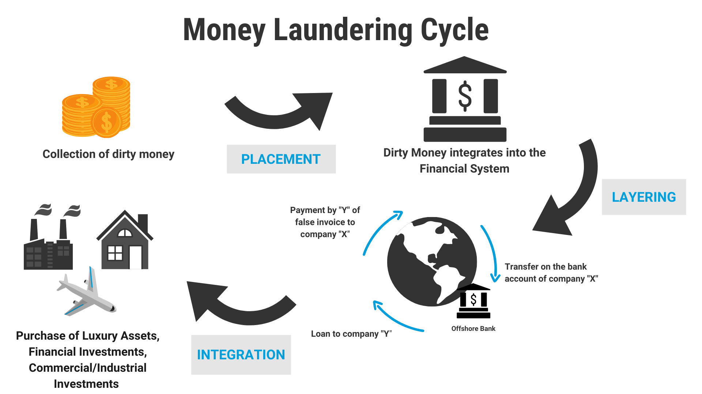
Stages of Money Laundering
Placement – Introducing illicit funds into the financial system.
Depositing large amounts of cash into banks.
Using smurfing (breaking down large sums into smaller deposits).
Buying high-value assets (e.g., luxury cars, real estate).
Layering – Obscuring the money's origin through complex transactions.
Moving money between multiple accounts and banks.
Using shell companies to mask the ownership.
Converting cash into cryptocurrencies.
Integration – Reintroducing laundered money into the legal economy.
Investing in businesses.
Purchasing legitimate assets.
Falsifying financial records to justify the income.

Slide 5

Why is AML Important?
Prevents financial crimes such as drug trafficking and terrorism financing.
Ensures financial institutions comply with international regulations.
Protects economic integrity by preventing illicit money from entering legal markets.
Why is Money Laundering a Threat?
Funds criminal activities like terrorism, drug trafficking, and corruption.
Undermines economic stability by distorting financial markets.
Leads to legal penalties and reputational damage for financial institutions that fail to prevent it.

Slide 6
THE RELATIONSHIP BETWEEN FRAUD AND ANTI-MONEY LAUNDERING (AML)
Fraud and Anti-Money Laundering (AML) are interconnected financial crimes that financial institutions must address through regulatory compliance and risk management
Overlapping Nature of Fraud and Money Laundering
Fraud Generates Illicit Funds: Many fraud schemes (e.g., identity fraud, transaction fraud, loan fraud) result in illegally obtained money.
Money Laundering Cleans Fraud Proceeds: Once criminals acquire illicit funds through fraud, they use money laundering techniques to disguise their origin, making the funds appear legitimate.
Both Aim to Evade Detection: Fraudsters and money launderers attempt to bypass financial monitoring systems to avoid getting caught.
Fraud and money laundering are closely linked, with fraud acting as the source of illicit funds and AML measures preventing criminals from successfully laundering these funds. Financial institutions must integrate fraud detection and AML compliance to effectively combat financial crime.

Slide 7
KEY DIFFERENCES BETWEEN FRAUD AND MONEY LAUNDERING
Aspect | Fraud | Money Laundering
Definition | Deception for financial gain. | Process of making illicit money appear legal.
Objective | Steal money from individuals, banks, or businesses. | Hide the source of illegally acquired money.
Process | Involves false transactions, identity theft, or manipulation. | Uses layering, structuring, and integration to clean money.
Who Commits It? | Individuals (identity fraud), insiders (employee fraud), or organized crime. | Criminal organizations, corrupt officials, and drug traffickers.
Regulatory Focus | Fraud detection & prevention measures (AI, rule-based alerts, KYC). | AML compliance laws (BSA, FATF, KYC/CDD requirements).
Example of Fraud-Linked Money Laundering
A cybercriminal steals banking credentials and transfers stolen money into a mule account.
The fraudster breaks the amount into smaller transactions (structuring) to avoid detection.
They use online gambling or cryptocurrency exchanges to clean the money.
The illicit funds are withdrawn from a new account, appearing as legal earnings.

